Slide 1



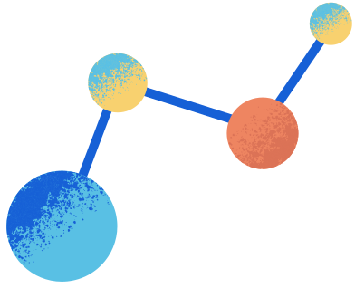

COEVOLUTIONARY LEARNING
SPATIALLY DISTRIBUTED POPULATIONS

Slide 2
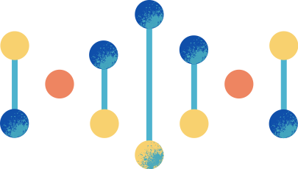



INTRODUCTION
01
COEV ALGO
02
Plan
OBJECTIVE
03
04
METHODS
05
CONCLUSION

Slide 3
01
INTRODUCTION

Slide 4

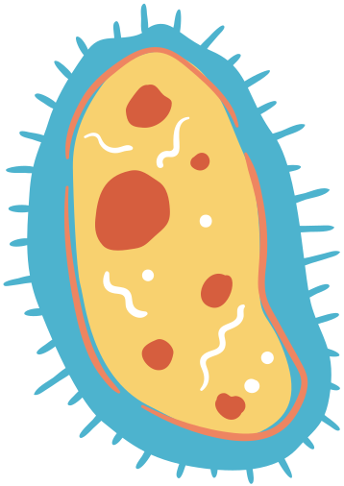






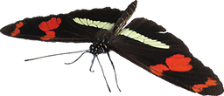




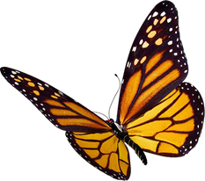
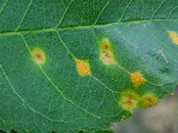

introduction:
inspiration came from host-parasite coevolution in nature One striking natural example is: "Egg mimicry"
The passion flower plant has evolved a protection against such parasitism by producing toxic chemicals in its leaves.
However, the genus of butterfly has evolved a counter-adaptation: its larva are able to tolerate these chemicals.
Insects such as butterflies sometimes lay their eggs on plant leaves, providing a ready food source for newly hatched larva.
the passion flower has evolved a remarkable yellow spots on its leaves that resemble butterfly eggs in order to avoid competition among larva.

Slide 5

In general, coevolutionary learning systems consist of two populations of individuals which evolve concurrently, with the fitness of individuals in each population depending on their interactions with individuals in the other population.
competitive cooperative

Slide 6
02
COEVOLUTIONARY
ALGORITHM

Slide 7


WHY TO USE COEV
01
FIRST ADVANTAGE
coevolution will be better able to preserve diversity in its populations than non-coevolutionary methods, since the environment for each population (i.e., the other population) is continually changing.

Slide 8

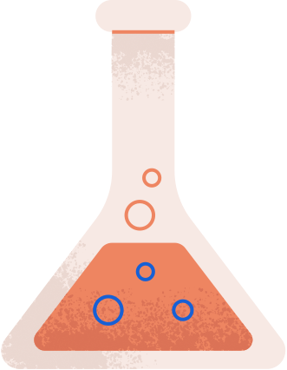
02
SECOND ADVANTAGE
parasites continually evolve to exploit the hosts’ weaknesses, coevolutionary arms races between the host and parasite populations will produce better performing, more general hosts.
03
THIRD ADVANTAGE
the hosts will learn successfully with many fewer training examples than needed in traditional machine learning approaches.

Slide 9
03
OBJECTIVE

Slide 10
EVOLVING CELLULAR AUTOMATA
A genetic algorithm is used to coevolve a population of 1-dimensional Cellular Automata (CAs) to solve the density > 0.5 task and perform the “density classification” task.
The goal was to find a CA that decides whether or not the IC contains a majority of 1s (has high density) or 0s.
The CA correctly classifies an Initial Condition (IC) if it returns a state vector of all 1s ,if the IC had a majority 1s and a vector of all 0s if the IC had a majority 0s.

Slide 11
ALGORITHM OVERVIEW
The program uses a coevolution "default" strategy, where the CAs are treated as the host population ,and the ICs are treated as a parasite population that competes with CAs to give them challenging problems.
The populations are represented as 20x20 grid of (CA, IC) pairs. The grid uses periodic boundary conditions, so the top row, is connected to the bottom row, and the left-most column is connected to the right-most column.

Slide 12
04
METHODS

Slide 13
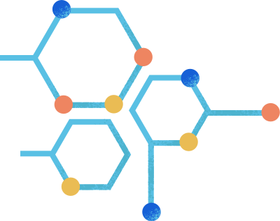








1. FITNESS CALCULATION
Calculate the fitness of each host h in the population using nine parasites
the parasite at the same site as h and the parasites at the eight neighboring sites.
Pi-1,hi-1
Pi-1,hi
Pi-1,hi+1
Pi,hi-1
Pi,hi
Pi,hi+1
Pi+1,hi-1
Pi+1,hi
Pi+1,hi+1

Slide 14
For each IC From those 9 parasites
if the CA correctly classifies it
num ++
if IC at the same site as CA //if((d==i) and (e==j))
if the CA correctly classifies it
ICFitness <-0
else
ICFitness <-| ic.density() - 0.5|
CAFitness <- num/9.0
IC fitness is only computed with respect to its paired CA. IC fitness is 0 if the CA correctly classifies it, and |density - 1/2| otherwise

Slide 15

2. SELECTION
For each host h, we are going to rank h along with the other eight hosts in its neighborhood according to fitness :
Pi-1,hi-1
Pi-1,hi
Pi-1,hi+1
rank 1
rank 2
rank 3
rank 9
Pi,hi-1
Pi,hi
Pi,hi+1
h3
h5
h4
.....
h7
Pi+1,hi-1
Pi+1,hi
Pi+1,hi+1
Each of these 9 hosts has probability of being selected equal to 0.5^rank
The selected host h′ replaces the host h in the center site of this neighborhood
The same selection procedure is applied to each parasite p

Slide 16
* for each neighbor of (i,j), collect associated ca,ic pair.
* sort this collection by fitness //sortByCA or IC Fitness(neighbors)
* select CA or IC such that that each has a (.5)^rank probability of being
selected. Except the last rank, which gets (.5)^8 so that it sums to 1.
N <- neighbors.length - 1
pour(i =0; i<N;i++)
probabilities[i] <- 0.5 ^ i+1
n <- probabilities.length
partition[0] <- probabilities[0]
pour ( i = 1; i < n; i++)
partition[i] <- partition[i-1]+probabilities[i];
0.5^1 0.5^1+0.5^2 0.5+..+0.5^3 ...... 1
*Randomly initialize num
if(num < partition[0]) return neighbors[0]
pour (i = 1; i < n; i++)
if((randomNum >= partition[i-1]) && (randomNum < partition[i]))
return neighbors[i]
return sorted_cells[n]
* Return the CA or IC

Slide 17
3.CROSSOVER OF HOSTS
Each site in the grid now contains a selected host h ′ and a selected parasite p ′.At each site, decide whether or not to perform a crossover according to the crossover probability. No crossover is done on ICs
Pi-1,hi-1
Pi-1,hi
Pi-1,hi+1
2.Selection
Selected
host
3.Crossover
h1
Pi,hi-1
Pi,hi
Pi,hi+1
randomly choose
Second
host h"
h2
Pi+1,hi-1
Pi+1,hi
Pi+1,hi+1
to form two offspring
Discard one of the offspring at random; the other one replaces h ′ in the center site using filpCoin (Random.nextInt(2)) ->0 :h1 , 1 :h2

Slide 18
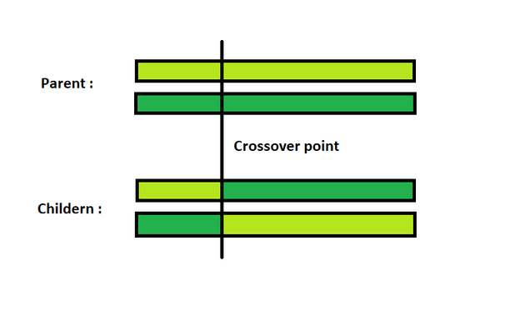
New Grid
for each site in the grid
newGrid[row][col] <- grid[row][col]
decide whether or not to perform a crossover according to the crossover
probability // si (Math.random < CROSSOVER_PROB)
currentCA <- newGrid.grid[row][col].ca //the selected CA
neighbors <- getNeighbors(row, col)
*randomly choose a second host h ′′ at a different site in the same neighborhood
index <- Math.random()*neighbors.size
otherCA <- neighbors[index].ca
newGrid[row][col].ca <- currentCA.crossover(otherCA)
retourner newGrid

Slide 19

4. MUTATION OF HOSTS:
Apply mutation to all hosts, according to the host mutation probability. In the cellular-automaton task, choose one or more bits and flip their values.
Bit1
Bit2
Bit3
....
Bitn-2
Bitn-1
Bitn
if Math.random() < PROB
Bit<-! Bit
Bit1
Bit2
Bit3
....
Bitn-2
Bitn-1
Bitn

Slide 20
MAIN ALGORITHM
*Initialize coev as a as 20x20 grid of (CA, IC) pairs
coev.init()
for (i=1;i<=MAX_ITER ; i++)
coev.computeFitness
bestCell <- coev.getBestCell() //bestCell a site in the grid pair of (CA,IC)
ic.init()
if the BestCell.ca correctly classifies this ic
write("Correct")
else
write("Incorrect")
nextGen <- coev.selectParents()
nextGen <- nextGen.crossoverCAs()
nextGen.mutate()
coev <- nextGen

Slide 21
05
CONCLUSION

Slide 22



CONCLUSION
spatial coevolution produced a majority of successful runs even though each host is evaluated on only 9 parasites.
spatial coevolution appears to maintain diversity in the populations for long periods of time and to foster continuing arms races, in which parasites continually evolve to target weaknesses in the evolving hosts.

Slide 23
THANK YOU!
Any questions? Don't hesitate to
ask for our help

